Slide 1

Live the better life

Slide 2



Slide 3
Introduction
When was the last time your random act of kindness made someone else’s day?
Often strangers make such a positive impact to our lives, that it lifts them up as well.
What is Level Up!
This is a database application that celebrates the spirit of doing random acts of kindness in between our daily lives.
By putting a structured system in place, the application is capable of quantifying such acts and reward the deserving ones using a game like simulation.
Take advantage of the apps model to receive exclusive benefits on your health insurance, loan interest rates, even get exemptions on your taxes! All this and much more only with ‘Level Up!’

Slide 4
“Kindness is not random, it is done on purpose”

Slide 5
Problem Statement
Human societies are highly dependent on each other.
How can we bring societies closer in the digital age to help those in need and receive help when we need it?
How can we foster the spirit in every individual to go out of their way and help the needy?
How can we ensure the doers amongst us get rewarded in a suitable manner?

Slide 6
Assumptions and Limitations
The authorities have given approval to share their data and update the data on a regular basis.
The users are motivated to help each other and receive help when in need.
The idea of cheating and exploiting the system is not exciting to them.
The app is being utilized to build a new fabric of society, which is bound to grow in the digital age, when personal human interaction is limited.

Slide 7
Walkthrough
The User will start at Level 1 and work his/her way up through the tasks to avail rewards.
The rewards will depend on the task performed and the points received to the user depending on the tasks performed.
The tasks vary from donating merchandise to helping the poor.
Doing these tasks will ensure the well being of a society as a whole and also be beneficial to the individual pertaining to the rewards criteria.
The user will have a range of tasks available to them depending on the level they are at.

Slide 8
Walkthrough
As they complete each task, they are assigned a certain amount of the points.
The task performed by them is validated by a government official that oversees their work and provides them with a token that the user can input in their system to get the points for that particular task.
The points can be cashed in for benefits that are given to them by the government agencies.
The higher the points, the wider the range of benefits that are available to them.
The application will need a proper system in place that will have the coordination of both the Government Agencies and the Users of the application.

Slide 9
User Stories
Forest Fires in California
Summer in California comes with bad memories from last year.
There was a record number of 8,527 fires in the state, setting ablaze an area of 1,893,913 acres(766,439 ha), the largest amount of burned acreage recorded in fire season history.
The fires were caused by both human mishap as well as natural causes.
This can be avoided to a certain extent by using the app.

Slide 10
Case 1
The popular tourist camping areas where cleaning of accumulated dry leaves was required were marked by authorities and uploaded on the app.
One such site was cleaned by Brian thereby ridding the site of any fuel for the fire to be caused.
The authorities approved Brian’s claim, and points were rewarded to him.

Slide 11
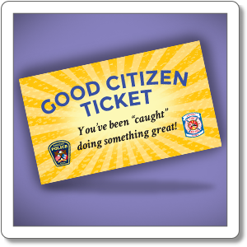

Slide 12
Case 2
When the fire breaks out, but hasn’t spread extensively: Before the firefighters arrived, the residents intimidated others on the app.
Kristina living in the neighborhood realized the emergency, and rushed to the location, controlling the fire from spreading far and wide.

Slide 13
Helping Homeless people in an emergency
Despite the advancements in the society we live in, there is still a certain section of citizens living in substandard conditions.
The homeless section of people deserves basic human rights, irrespective of the conditions.
Bob, a homeless person got severely injured and was bleeding.
He seeked for help on the app.
Dana, a user living nearby helped him with applying bandage and dressing.
Once accomplished, she addressed the task on the app to claim her points.

Slide 14
Volunteering at the Orphanage
On reaching a higher level of the game, every user must take out time to do volunteering work.
Jack agreed to work in the orphanage and helped teach underprivileged children on weekends.
He taught them mathematics, and Science.
Similarly, Julie was responsible for working at a Soup Kitchen and helped prepare meals that could feed over 1500 underprivileged people.

Slide 15
Encouraging a dormant User
Adrian has been consistently taking up tasks on the app.
He went out of his way at times and performed over five tasks in a single day, some of which were quite challenging.
This allowed Adrian to unlock higher levels in the game, taking him closer to a reward.
Recently, Adrian has been keeping busy.
The app notifies Adrian that he hasn’t picked up any task for the past two weeks, and that he must take up at least one task in the next 24 hours to be able to maintain his eligibility for the reward.
Adrian is now motivated to do at least some community work despite his hectic schedule.

Slide 16
Penalizing a user who’s task is incomplete
Giselle is moving some furniture into her apartment on the 3rd Floor and could use some help with it.
She sets up a request seeking help and offers 15 points from her points bank.
Sarah gets the notification and agrees to help Giselle.
They were supposed to meet at the predetermined time and location.
Sarah does not turn up at the predetermined time and comes 30 minutes late.
Sarah was unable to finish the task in the predetermined Time Frame.
Sarah had to pay a penalty of 30 points for not showing up on time.

Slide 17
TECHNICAL DETAILS
Looking at the Database Features of the Application

Slide 18
Components
17 Tables
3 Views
5 Stored Procedures
3 Triggers
1 Function
Grants

Slide 19
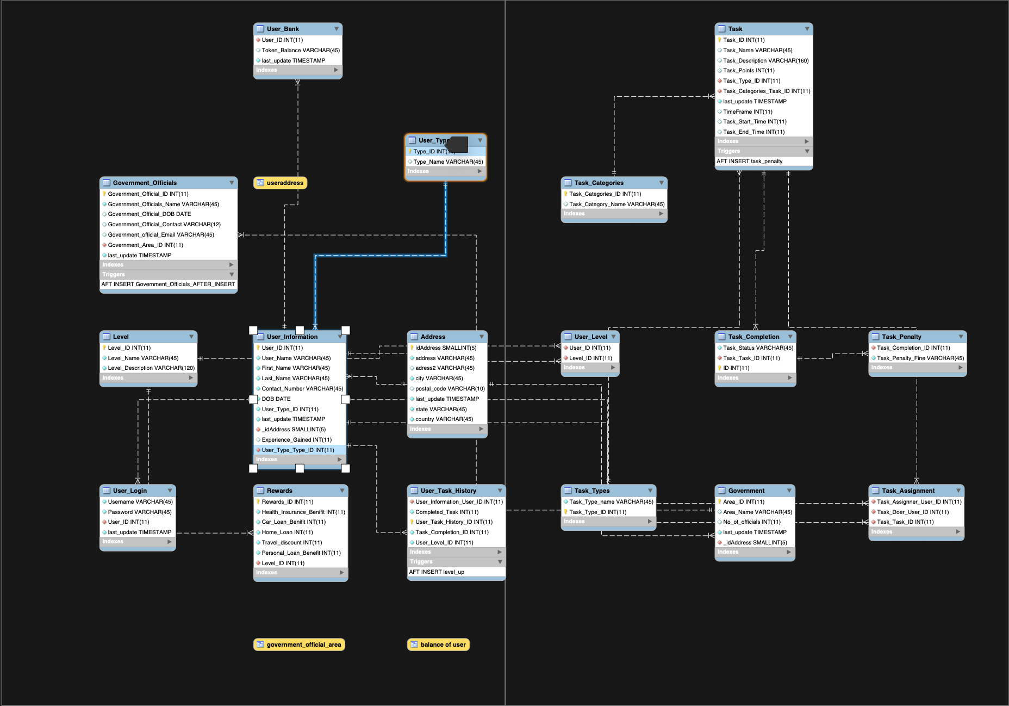
ER DIAGRAM

Slide 20
TABLES
S.No. | Table Name | Primary Key | Foreign Key(s)
1. | Address | idAddress | -
2. | Government | Area_ID | _idAddress
3. | Government Officials | Government_Official_ID | Government_Area_ID
4. | Levels | Level_ID | -
5. | Rewards | Rewards_ID | Level_ID
6. | Task | Task_ID | Task_Categories_Task_ID; Task_Type_ID
7. | Task Assignment | - | Task_Assigner_User_ID; Task_Doer_User_ID; Task_Task_ID
8. | Task Category | Task_Categories_ID | -

Slide 21
TABLES
S.No. | Table Name | Primary Key | Foreign Key(s)
9. | Task Completion | ID | Task_Task_ID
10. | Task Penalty | - | Task_Completion_ID
11. | Task Types | Task_Type_ID | -
12. | User Bank | - | User_ID
13. | User Info | User_ID | _idAddress
14. | User Level | - | User_ID; Level_ID
15. | User Login | - | User_ID
16. | User Task History | User_Task_History_ID | User_Level_ID; User_Information_User_ID
17. | User Type | Type_ID | -

Slide 22
Views
Balance of user
Government official Area
User Address

Slide 23
Stored Procedures
Add Task
Add User
People at Level
Task Assignment
User Rewards

Slide 24
Triggers
Level Up
Government Officials
Task Penalty

Slide 25
Roles and Privileges
Normal User
Admin
Government

Slide 26
THANKS!
Team: Data Diggers Krisha Shah Mansi Pandya Pratham Patel Vivek Dixit Yash Oza

